Slide 1
PROJECT ON SMART FARMING USING PRECISION – AGRICULTURE RECOMMENDATION SYSTEM USING ML
Project SYNOPSIS PRESENTATION
Candidate Name: Apoorva Mathad
Qualification: MBA
Candidate Name: Keerti Ramesh
Qualification: BSC
Candidate Name: Rekha Koyappanavar
Qualification: BCA
Project Supervisor Details: Mohammad Tahir Mirji(M-Tech)

Slide 2
INTRODUCTION
India ranks second in the world in farm output but 64% of cultivated land depends on the monsoons. Irrigation accounts for nearly 85% of water and nearly 60% of water is wasted during irrigation.
Precision agriculture can be defined as “the application of modern information technologies to provide, process, and analyze multi-source data of high spatial and temporal resolution for decision making and operations in the management of crop production.
This Precise agriculture may give rise to enhance productivity, Soil degradation, Efficient water usage, reduction in chemical usage for cultivation, dissemination of modern farm practices to improve quality, quantity, and cost of production in crops. By incorporating Agriculture IoT solutions are focused on helping farmers close the supply-demand gap, by ensuring high yields, profitability, and protection of the environment.
Precision agriculture also known as smart farming have emerged as an innovative tool to address current challenges in agricultural sustainability. The mechanism that drives this cutting edge technology is machine learning (ML). It gives the machine ability to learn without being explicitly programmed. ML together with IoT (Internet of Things) enabled farm machinery are key components of the next agriculture revolution.

Slide 3
Why we are doing this project
The areas that are focused are prediction of soil parameters such as organic carbon and moisture content, crop yield prediction, disease and weed detection in crops and species detection. ML with computer vision are reviewed for the classification of a different set of crop images in order to monitor the crop quality and yield assessment.
This approach can be integrated for enhanced livestock production by predicting fertility patterns, diagnosing eating disorders, cattle behavior based on ML models using data collected by collar sensors, etc. Intelligent irrigation which includes drip irrigation and intelligent harvesting techniques are also reviewed that reduces human labour to a great extent. This demonstrates how knowledge-based agriculture can improve the sustainable productivity and quality of the product.

Slide 4
Operational Benefits
Today, even drones are extensively used in agriculture for research analysis, safety, rescue, terrain scanning, spatial analysis, monitoring soil hydration, identifying yield problems, etc.
These smart drones even pinout and precisely spray pesticides on the diseased plants from the vast expanse of farmlands, help add micro and macronutrients, check physical properties such as moisture, chemical properties, pH balance by adding lime, etc.
Precision Agriculture along with an AI-powered application facilitates in identifying the match case – tell what disease has crippled the plant and later, match it from the list of its disease imagery database, send corrective measures and so on. So, the possibilities with AI and data analytics seem endless in Precision Agriculture. The collected and analyzed data will be sent as per the farmers’ requirements and needs.
AI combined with ML, Big Data Analytics and IoT-powered smart edge devices like GPS, drones, sensors, RFID & LED lights are widely used in livestock monitoring, fish farming and smart greenhouses.

Slide 5
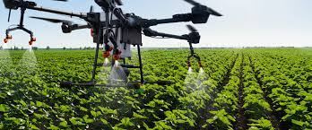

Slide 6
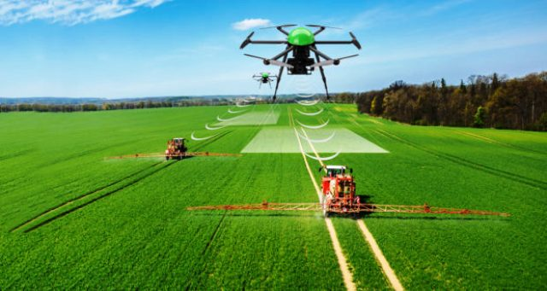
Technical Concepts or Base of projects
Precision agriculture (PA) is the science of improving crop yields and assisting management decisions using high technology sensor and analysis tools. PA is a new concept adopted throughout the world to increase production, reduce labor time, and ensure the effective management of fertilizers and irrigation processes.
Precision agriculture (PA) is a farming management concept based on observing, measuring and responding to inter and intra-field variability in crops.

Slide 7
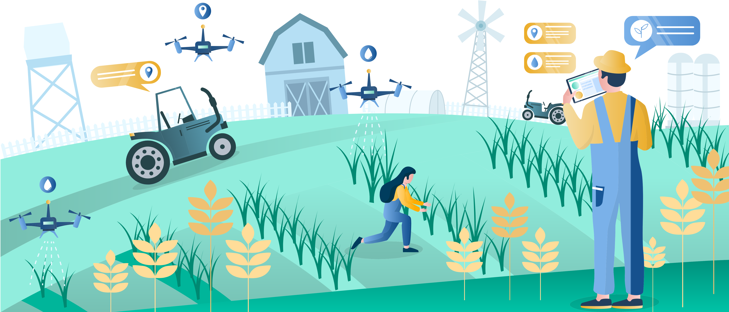
The techniques of smart farming?
Smart farming, which involves the application of sensors and automated irrigation practices, can help monitor agricultural land, temperature, soil moisture, etc. This would enable farmers to monitor crops from anywhere.
The aims and objectives of precision agriculture.
To increase the accuracy and efficiency of agricultural input applications. To conduct lab and field experiments and researches on the economic and environmental negative impacts of agricultural chemical misapplications.

Slide 8
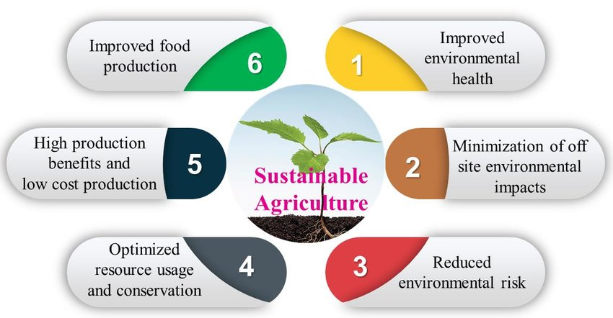
What is sustainable agriculture?
Green agriculture is the application of the sustainable development principles to agriculture: ensuring the production of food, wood and fibers while respecting the ecological, economic and social limits that ensure the durability of this production. For instance, sustainable farming minimizes the use of pesticides that can harm the health of farmers and consumers.
Sustainable agriculture advantages
ENVIRONMENTAL PROTECTION
PUBLIC HEALTH IMPROVEMENT
ECONOMIC AND SOCIAL EQUITY

Slide 9
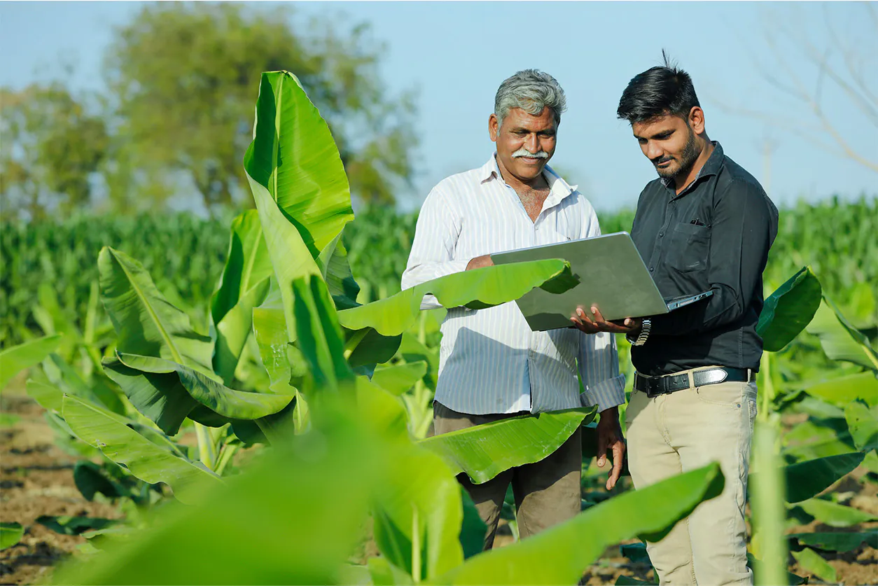
Who will be benefited
Smart farming helps farmers to better understand the important factors such as water, topography, aspect, vegetation and soil types. This allows farmers to determine the best uses of scarce resources within their production environment and manage these in an environmentally and economically sustainable manner.
Precision agriculture leverages technologies to enhance sustainability through more efficient use of land, water, fuel, fertilizer and pesticides. Essentially, farmers who use precision agriculture technologies use less to grow more, reducing both cost and environmental impact

Slide 10
Challenges if any
1. Food security and productivity
Sustainable agriculture will have to prove itself facing with intensive agriculture. Even though it is more reasonable, it cannot offer the same short-term returns.
With the growing population and the persistently high levels of hunger and malnutrition, sustainable agriculture yields need to address the food security issue by producing more in less time, while using fewer natural resources.
2. Natural resources availability
The other big challenge that green agriculture is facing is undoubtedly the rapid degradation and depletion of natural resources.

Slide 11
What is the outcome and what is the major change that will create impact
The application of the above technologies has a positive impact on agriculture and cattle farming. Let's take a look at some of these improvements:
Increased production: the optimization of all the processes related to agriculture and livestock-rearing increases production rates.
Water saving: weather forecasts and sensors that measure soil moisture mean watering only when necessary and for the right length of time.
Better quality: analysis of the quality of the produce obtained in relation to the strategies applied makes adjustments possible to increase subsequent production quality.
Reduced costs: automation of sowing, treatments and harvesting in the case of agriculture reduces the use of resources.
Pest detection and animal health: early detection of infestations in crops or sickness in animals means that their impact on production can be minimized and animal welfare improved.
Better sustainability: saving resources like irrigation water and getting maximum benefit from the land reduce the impact on the environment.

Slide 12
What is the outcome and what is the major change that will create impact contd
Reduced costs
Increased Profitability
Enhanced Sustainability
Better Harvest ability
Increased Land Values
Higher Resolutions Understanding of Your Farm
Better In season Yield Understanding

Slide 13
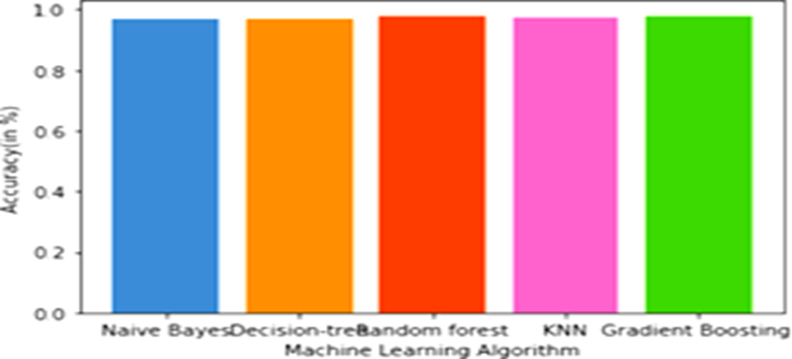
Statistical Analysis

Slide 14
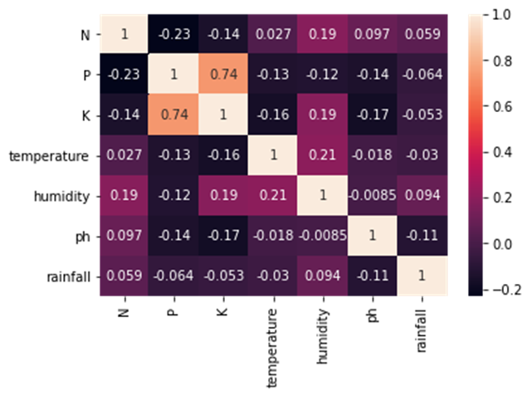

Slide 15
References

Slide 16
THANK YOU

